Slide 1
WWA Advocacy

Slide 2
Warmup
Talking about WIC can help:
Improve participant recruitment
Encourage Congress to enact possible policies to support the implementation of WIC communities across the country
Increase public support for the program which affects the above

Slide 3
What is WWA?
Mission: To inspire and empower the Wisconsin WIC community to advocate for and promote quality nutrition services and assure effectiveness through collaboration, cooperation and education.

Slide 4
Advocacy
What is advocacy?
The process of supporting a proposal or a cause
Educating various stakeholders
Public, WIC participants, Community partners, Policymakers

Slide 5
Advocacy
Importance of WIC advocacy
Ensures targeted audiences understand:
Scope and focus of WIC
Value of WIC to individuals, communities, local economies, and nation
Ensures that WIC is not confused with other programs such as SNAP
Provides opportunities to describe the value proposition of WIC in many ways

Slide 6
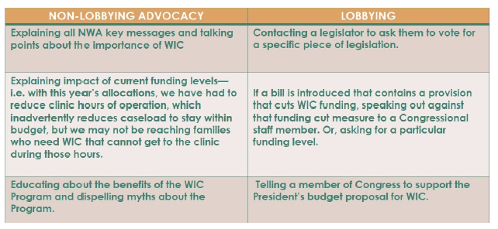
Advocacy v. Lobbying
Advocacy is not lobbying

Slide 7
Examples of non-lobbying activities:
Educating the public and members of Congress about WIC
Highlighting the achievements of WIC clinics in the media
Hosting events that promote, celebrate, or inform about WIC
Hosting a member of Congress to tour your WIC clinic
Offering to be a resource of information for Congressional staff in the future
Providing data on your state or local agency
Describing personal stories of WIC impact in your clinic
Describing the importance of Breastfeeding peer counselors
Explaining the benefits of EBT to WIC
Explaining how your clinic responded to budget cuts

Slide 8
Advocacy & Marketing
Marketing is defined as:
“Marketing is the activity, set of institutions, and processes for creating, communication, delivering, and exchanging offerings that have value for customers, clients, partners, and society at large”~ American Marketing Association
*Reach one, teach one; Teach one, reach one*

Slide 9
WIC Key Messages
WIC strengthens families
WIC’s Four Service Pillars
Healthy foods
Nutrition education
Breastfeeding support (including peer counselors)
Health care referrals
Positive outcomes
Improved health benefits
Diets, breastfeeding rates
Improves health outcomes
Birth outcomes, children arrive to school ready-to-learn
Health care savings

Slide 10
WIC Key Messages
WIC is a well-liked program
Admired across political, ideological, ethnic, and socio-economic groups, and voters overwhelmingly oppose cutting funding for WIC
Participants are thankful for the program
Participant recruitment
Person-to-person outreach
Media
Local and National organizations (WWA and NWA)

Slide 11
How to Talk About WIC
Personalizing WIC messages: Communication of your WIC value statement
Establish your WIC value statement
What is WIC?
How does it add value?
Focus your value communications
Your role in WIC is unique
You can speak first hand to certain messages
Include stories
How has WIC impacted your life
How has WIC impacted the life of families in your community

Slide 12
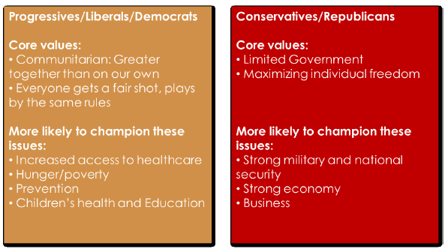
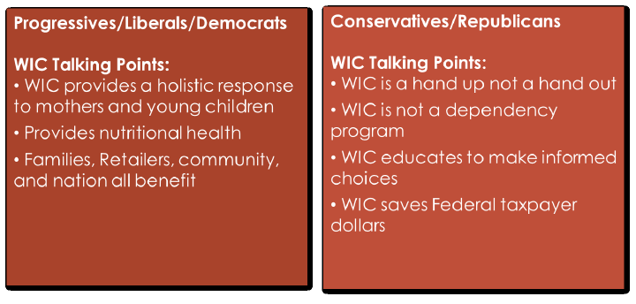
Targeting Messages
Targeting messages to Democrats and Republicans

Slide 13
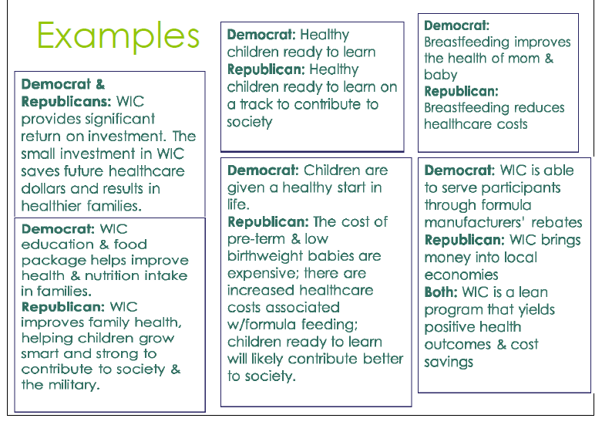
Elected Officials
Targeting messages to elected officials.
Notes:
What issues do your Members of Congress focus on?
What interests do they have?
Do they have a family?
What is their political ideology?

Slide 14
Find Your Elected Official
Local Level Representatives
http://legis.Wisconsin.gov
National Representatives
https://en.wikipedia.org/wiki/115th_United_States_Congress

Slide 15
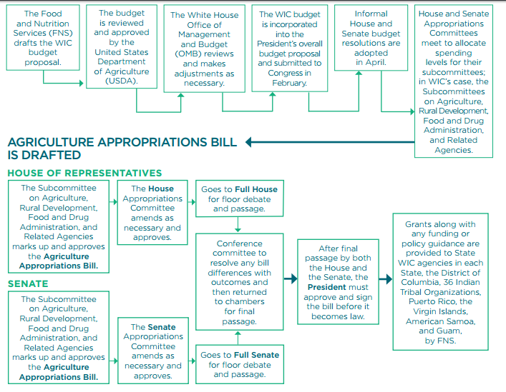
How is WIC Funded

Slide 16
Glossary
Markup
The process by which congressional committees and subcommittees debate, amend, and rewrite proposed legislation.
Appropriation
The provision of funds, through an annual appropriations act or a permanent law, for federal agencies to make payments out of the Treasury for specified purposes.

Slide 17
#wicworks
Now that you have this information, WWA needs you to share the message. We have created tools to aid in this process.
WWA Contact Information: http://wiwica.org/
Find us on Facebook: Wisconsin WIC Association (@WISCONSINWICASSOCIATION)

